Slide 1


How to make USB thumb Drive to booting
1. Preparation
1) USB Thumb Drive(over 16GB, USB 3.0, Recommend 64GB, USB 3.0)
2) Laptop or Desktop PC
2. Download the win64 winpe files from the link in the email and any other relevant files.
3. Extract the zip file to a location on your PC
4. Connect USB Thumb Drive to Laptop or Desktop PC
5. Run “Disk Management”
6. Remove the whole volume of USB Thumb Drive
7. Make New simple volume(for boot partition)
- Simple Volume Size : 500MB
- Drive Assign : F
- File System : FAT32
- Volume Label : WINP64
8. Make New simple volume(for store BIOS and Windows Image)
- Simple Volume Size : Remained
- Drive Assign : G
- File System : NTFS
- Volume Label : ImageSET

Slide 2
How to make USB thumb Drive to booting
9. Copy the contents of the win64 extracted files to the WINP64 partition.
10. Copy extact and Copy DMI files or image files to root of ImageSet partition on the USB stick
Eject the USB stick just created and insert into the device you are updating the bios to. While booting the device press the F10 key to bring up the boot menu at post.
Select the USB Drive from the menu and hit enter.

Slide 3
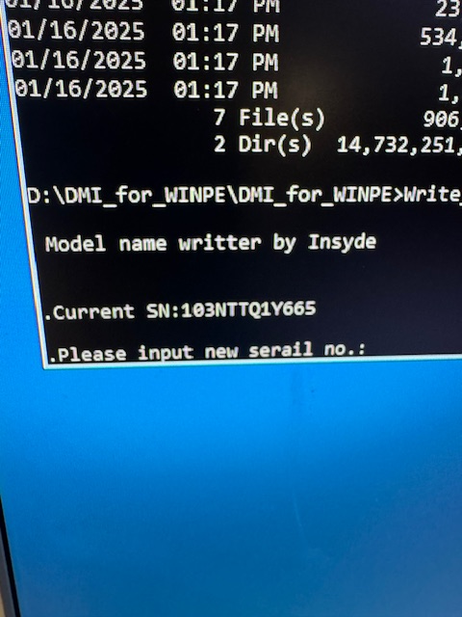
WINPE will load and a dos prompt will come on the screen.
Type dir and hit enter. If the drive was created correctly, you should see the DMI files you copied. Execute the DMI update by typing Write_SN.cmd. The following screen will appear.
Current SN will be displayed. Enter New SN and press enter.
CMOS will be updated and device will SHUT DOWN when completed.
Remove WINPE USB Stick, power on the AIO and press F2 to enter the bios. Verify the SN is correct.
If no files are present you will need to change drive letters until you see the DMI files you copied to the ImageSET drive. They will most likely be in the D:\ E:\ or F:\ drives.

